Slide 1

AI and Covid - Presentation 4
Prof. Dr. Maria A. Wimmer, wimmer@uni-koblenz.de
Dr. Ulf Lotzmann, ulf@uni-koblenz.de
http://www.uni-koblenz.de/agvinf/
SoSe 2022

Slide 2
Team Members:
Irshad Hussain Mohammed
Manpreeth Vankadara
Nirav Satani
Pavan Kumar Tokachichu
Pavan Kumar Reddy Kancharla
Peram Navachandu Reddy
Ramesh Reddy Modulla
Rehan Ali Syed
Sudheer Kumar Gandham
Venkata Satya Aditya Jagarlapudi

Slide 3
Incidence Response Model for Global Pandemics

Slide 4
Agenda For The Meeting
Revised Documentation
Revised Minutes of Meeting
Cloud Updated
Architecture
Correlation between Population density, flights, and Covid
Data Prepared for analysis
Flowchart of Algorithms to be used

Slide 5
Updated Cloud - Github
Updated Project Management Application
Updated Minutes of Meetings
Updated Documentation
Updated Gantt Chart

Slide 6
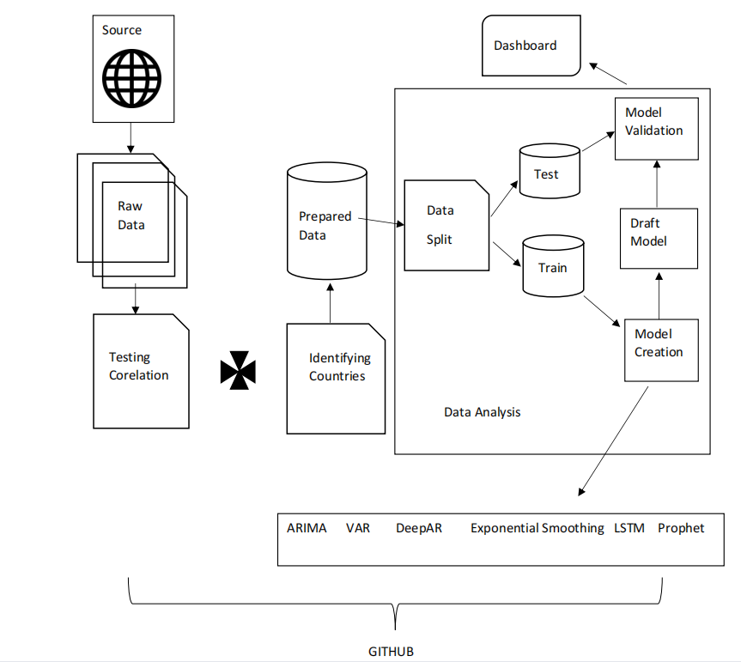
Architecture :

Slide 7
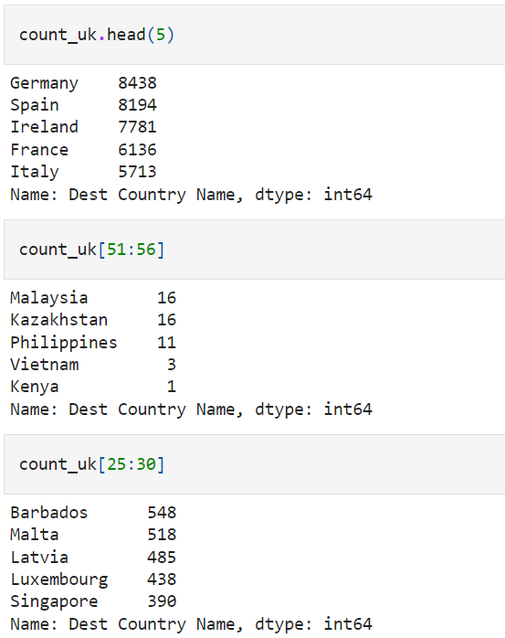
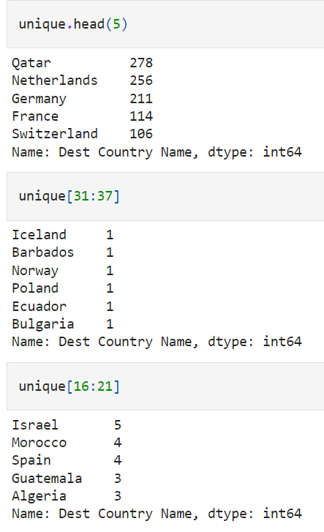
Classification based on Traffic from South Africa and United Kingdom

Slide 8
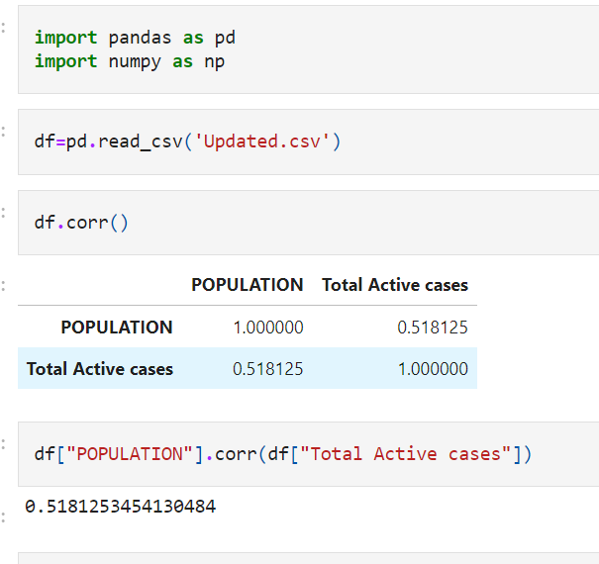
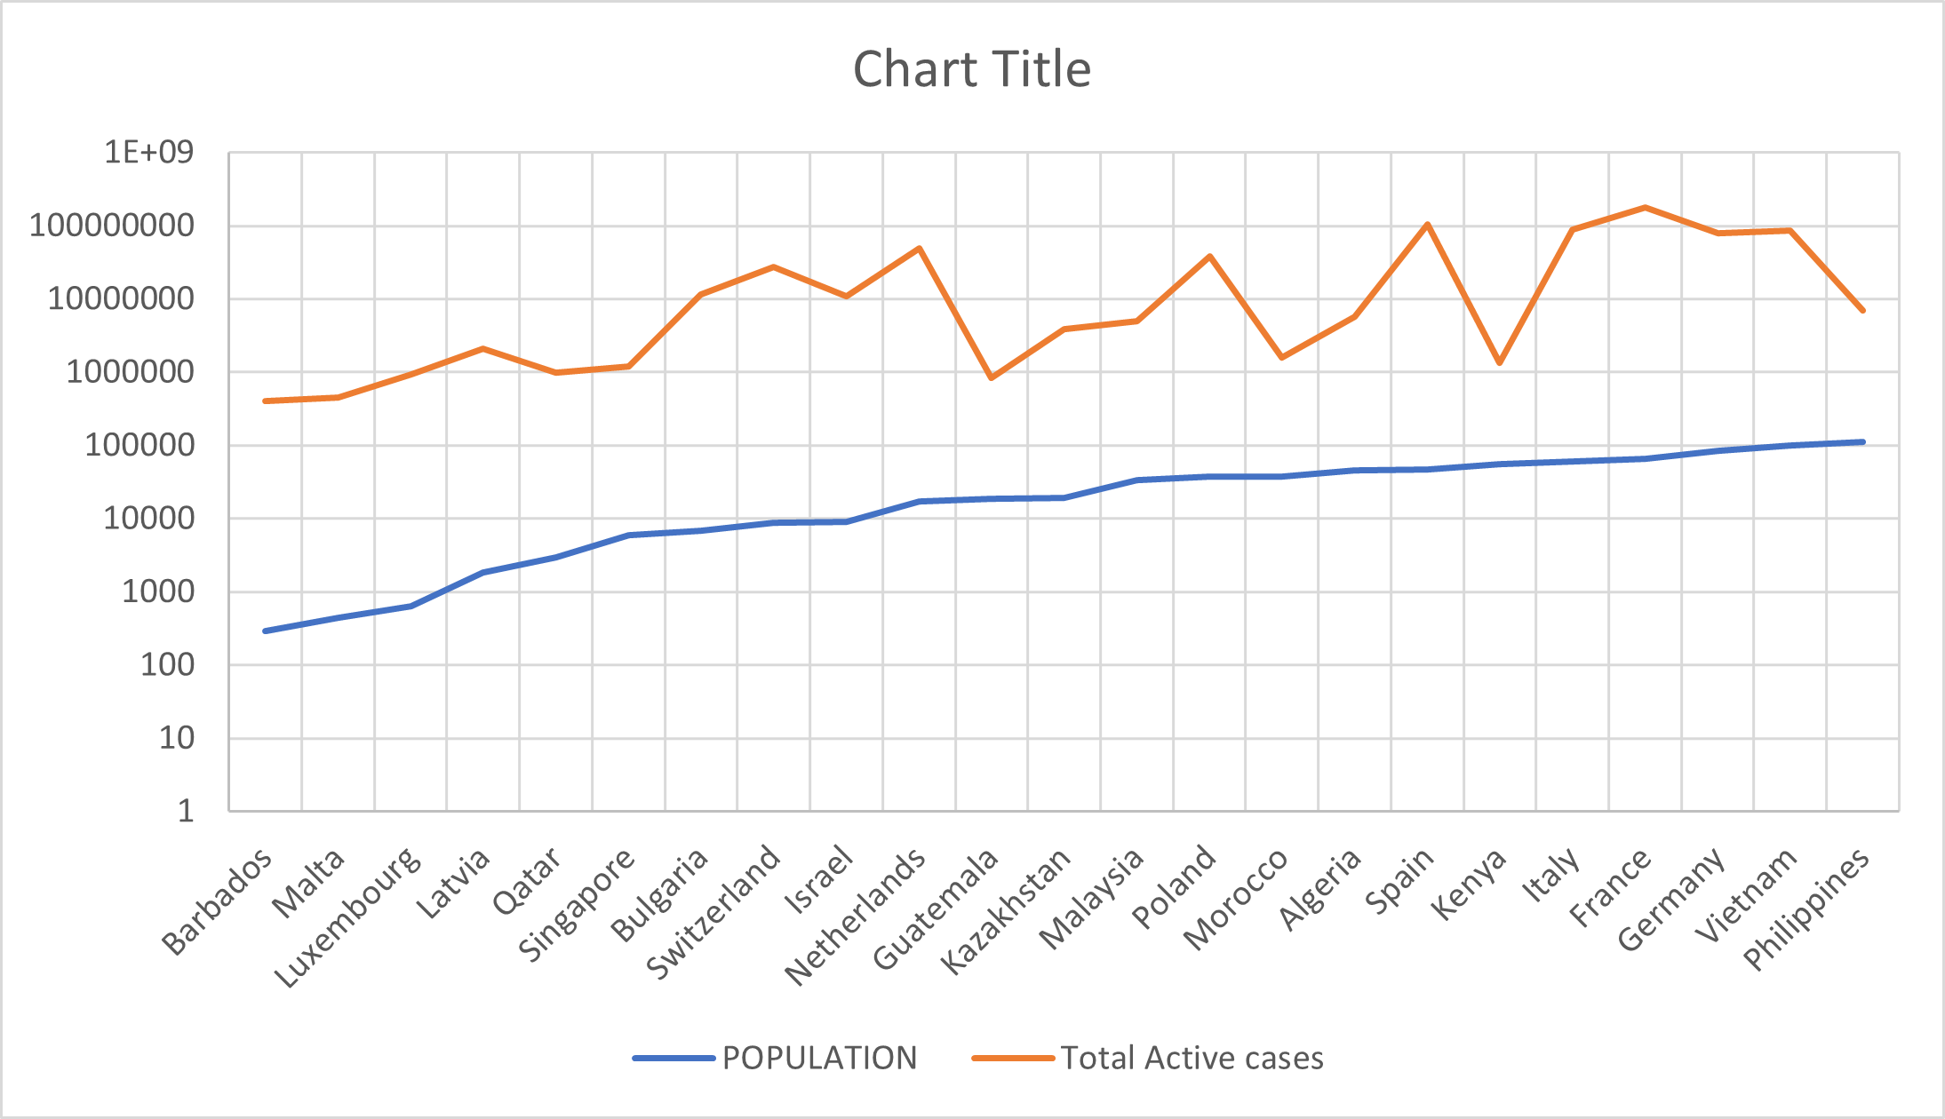
Evidence Of Correlation - Population

Slide 9
Evidence Of Correlation - Flights

Slide 10
Data Prepared for Anaysis

Slide 11
Algorithms Flowchart

Slide 12
Thank You

